Slide 1
Food Truck Database
Sai Sri Harsha Kumbam

Slide 2

Business Objective
We made a database for a local food truck.
Database inventories information about the orders placed, employees, customer information, and menu.
Fulfills the requirement of tracking and placing orders, retrieving customer and employee information.
Database also retrieves orders placed by customer during a certain period.

Slide 3
Business Rules
Customers & employees can search through the menu and view menu items, prices, and inventory levels.
Employees can adjust menu items and prices.
Employees can put in the order.
After a purchase, the DB will update inventory levels.

Slide 4
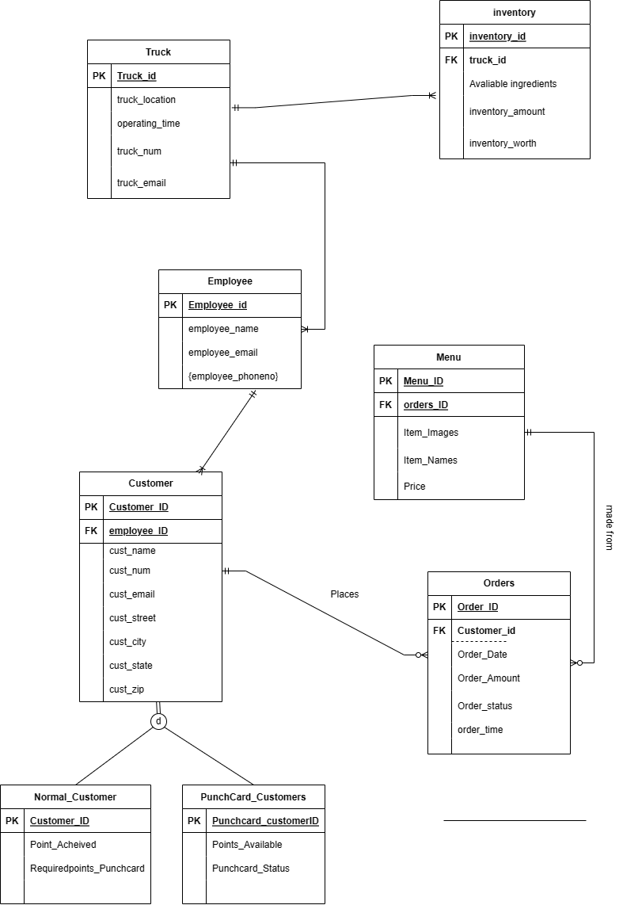
ERD Diagram

Slide 5
Entities + Attributes
Customer
Cust_ID (pk)
Cust_name
Cust_email
Cust_phno
Cust_street
Cust_city
Cust_state
Cust_zip
Employee
Emp_id (pk)
Emp_name
Emp_email
Emp_phno
Emp_street
Emp_city
Emp_state
Emp_zip
Orders
orders_id (pk)
Orders_date
orders_amount
Cust_id (fk)
Inventory
Inv_id (pk)
Truck_id (fk)
Inv_amount
Inv_worth
Ingredients_available
Truck
truck_id (pk)
Truck_location
Operating_days
Truck_num
Truck_email
Menu
Menu_id (pk)
Menuitem_name
Menuitem_price
Normal customer
normalCust_id
Points_acheieved
Requiredpoints_punchcard
Punchcard_customer
Punchcard_customerid
Points_available
Punchcard_status

Slide 6
Queries
Query to return customer ID and Customer name who lives in “Baltimore”
Query to return Menu ID, MenuItem Name and MenuItem Price that costs greater than 12.50
Query to return information of the employee who lives in Newyork
Query to return Order Date and Order ID of the orders which were placed after 11-Apr-2023
Query to return Number of Points achieved by the customer and their respectives Id’s whose points are greater than 50
Query to return customer contact info that contains ‘%r%’ in their name
Query to update the inventory amount of the truck whose id is ‘102’.
Query to update employee address with name ‘John’.
Query to update customer name and street address having id = 3.
Query to return the details of ingredients available in the trucks.
Query to return the details of the customer who has given specific orders.
Query to return the name and phone number of customer who have achieved more than 50 points

Slide 7
Select queries
Query to return customer ID and Customer name who lives in “Baltimore”
Query to return Menu ID, MenuItem Name and MenuItem Price that costs greater than 12.50
Newyork
select cust_id,cust_name
from customer
where cust_city='Baltimore';
select menu_id, menuitem_name, menuitem_price
from menu
where menuitem_price>12.50;

Slide 8
Select queries cont.
Query to return information of the employee who lives in Newyork
Query to return Order Date and Order ID of the orders which were placed after 11-Apr-2023
Newyork
select * from employee
where emp_city='Newyork';
select orders_date, orders_id
from orders
where orders_date>'11-Apr-2023';

Slide 9
Select queries cont.
Query to return Number of Points achieved by the customer and their respectives Id’s whose points are greater than 50
Query to return customer contact info that contains ‘%r%’ in their name
Newyork
select points_acheived, normalcust_id
from normal_cust
where points_acheived > 50;
select c.cust_id,c.cust_name,c.cust_email
from Customer c
where cust_name like '%r%';

Slide 10
Update queries
Query to update the inventory amount of the truck whose id is ‘102’.
Query to update employee address with name ‘John’.
Newyork
update inventory
set inv_amount=inv_amount+250
where truck_id=102;
update employee
set emp_street='Mount Ridge'
where emp_name='John';

Slide 11
Update queries cont.
Query to update customer name and street address having id = 3.
Newyork
update customer
set cust_name='Tejo Venkatesh’, cust_street='Charles St'
where cust_id=3;

Slide 12
Join queries
Query to return the details of ingredients available in the trucks.
Query to return the details of the customer who has given specific orders.
SELECT t.truck_id, i.ingredients_available
FROM truck t
join inventory i on t.truck_id=i.truck_id;
select c.cust_id, o.orders_id, c.cust_name
from customer c
join orders o on c.cust_id=o.cust_id;

Slide 13
Join queries cont.
Query to return the name and phone number of customer who have achieved more than 50 points
Newyork
SELECT c.cust_name, c.cust_phoneNo
FROM Customer c
JOIN normal_cust nc ON c.cust_id = nc.cust_id
WHERE nc.points_acheived > 50;

Slide 14
Group By
Query to return the number of orders given by customers.
Query to return the total points achieved by the customers.
Newyork
SELECT c.cust_name, COUNT(o.orders_id) AS total_orders
FROM Customer c
JOIN Orders o ON c.cust_id = o.cust_id
GROUP BY c.cust_name;
SELECT c.cust_name, SUM(pc.points_available) AS total_points
FROM Customer c
JOIN punchcard_cust pc ON c.cust_id = pc.cust_id
GROUP BY c.cust_name;

